Slide 1
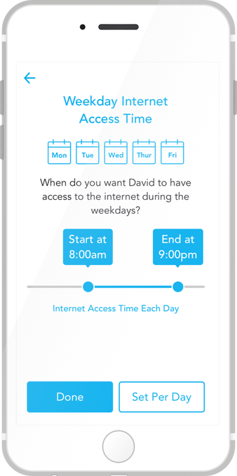

Be Honest
Kindergarten
Be Honest With Yourself Online
App of the Month
When you need to take a step back from your phone, unGlue is here to help you out! This app helps limit phone use. You can set up daily limits for apps that can distract you from having fun with your friends!
It’s important o unplug from your device every now and then so you can be honest with yourself! What fun things will you do with your extra time?
#Innovation Challenge
What’s the longest you have gone without being on a device? What is your favorite activity that doesn’t include a device?
“Take a step back, evaluate what is important, and enjoy life.” – Teri Garr

Slide 2
Be Honest
1st-2nd Grade
Be Honest With Yourself Online
App of the Month
When you need to take a step back from your phone, unGlue is here to help you out! This app helps limit phone use. You can set up daily limits for apps that can distract you from having fun with your friends!
It’s necessary to unplug from your device every now and then so you can be honest with yourself! It gives you extra time too!
#Inovation Challenge
What’s the longest you have gone without being on a device? Start spending less time on a device and keep track of how you feel each day!
“Take a step back, evaluate what is important, and enjoy life.” – Teri Garr

Slide 3
Be Honest
3rd-5th Grade
Be Honest With Yourself Online
App of the Month
When you need to take a step back from your phone, unGlue is here to help you out! This app helps limit phone use so you can focus on what really matters – real life. You can set up daily limits for apps that can distract you from reaching your goals, and you can even earn minutes of screen time by being physically active!
It’s necessary to unplug from your device every now and then so you can be honest with yourself and make a positive change!
#Innovation Challenge
What’s the longest you have gone without being on a device? Start spending less time on a device and keep track of how you feel each day!
“Take a step back, evaluate what is important, and enjoy life.” – Teri Garr

Slide 4
Be Honest
6-8th Grade
Be Honest With Yourself Online
App of the Month
When you need to take a step back from your phone, unGlue is here to help you out! This app helps limit phone use so you can focus on what really matters – real life. You can set up daily limits for apps that can distract you from reaching your goals, and you can even earn minutes of screen time by being physically active!
It’s necessary to unplug from your device every now and then so you can be honest with yourself and make time for other things, such as homework!
#Innovation Challenge
What’s the longest you have gone without being on a device? Try to go a week without using half of your average screen time. Do you see a difference?
“Take a step back, evaluate what is important, and enjoy life.” – Teri Garr

Slide 5
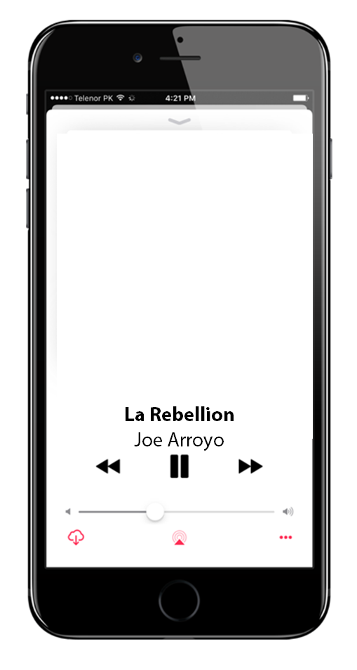
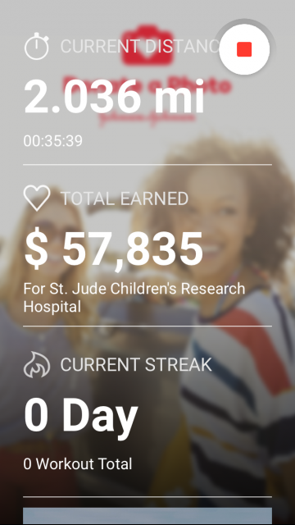
Be Considerate
Kindergarten
Be Considerate Online
App of the Month
Get moving with Charity Miles, a free fitness app that you allows you to help charity whenever you walk, run, bike, or even dance! Just download the app and help communities around the world. The more you move, the more you raise!
We can be Considerate of our technology by using apps that make a positive impact on the world around us!
#Inovation Challenge
What is your favorite way to help others? Encourage your classmates, friends, or families to try to help others too!

Slide 6
Be Considerate
1st-2nd Grade
Be Considerate Online
App of the Month
Get moving with Charity Miles, a free fitness app that you allows you to help charity whenever you walk, run, bike, or even dance! Just download the app and help communities around the world. The more you move, the more you raise!
We can be Considerate of our technology by using apps that make a positive impact on the world around us!
#Innovation Challenge
What is your favorite way to help others? Encourage your classmates, friends, or families to get moving to make a difference with this app! Can you make it a family effort?

Slide 7
Be Considerate
3rd-5th Grade
Be Considerate Online
App of the Month
Get moving with Charity Miles, a free fitness app that you allows you to earn money for charity whenever you walk, run, bike, or even dance! Just download the app and pick from over 40 world-class charities that help communities around the world. The more you move, the more you raise!
We can be Considerate with our technology by using apps and visiting websites that make a positive impact on the world we live in!
#Inovation Challenge
Think of a cause you’re really passionate about, try to find a charity that helps that cause on the Charity Miles app, and encourage your classmates, friends, or families to get moving to make a difference!

Slide 8
Be Considerate
6-8th Grade
Be Considerate Online
App of the Month
Get moving with Charity Miles, a free fitness app that you allows you to earn money for charity whenever you walk, run, bike, or even dance! Just download the app and pick from over 40 world-class charities that help communities around the world. The more you move, the more you raise!
We can be Considerate with our technology by using apps and visiting websites that make a positive impact on the world we live in!
#Inovation Challenge
Why do you consider this when volunteering and working with charities? Why do you think it can be important? Encourage your classmates, friends, or families to get moving to make a difference too with Charity Miles!

Slide 9
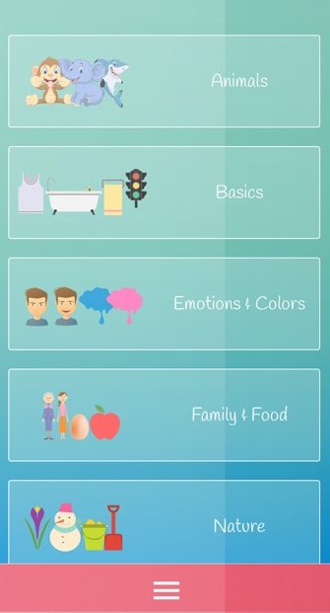
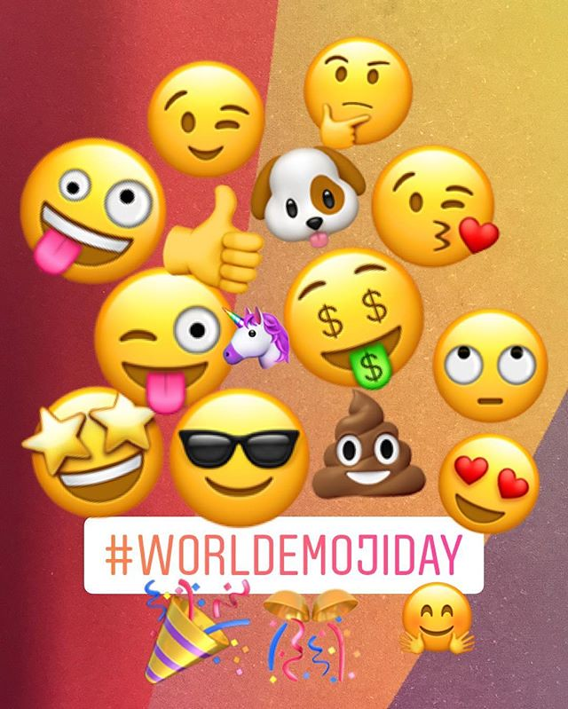
Be A Friend
Kindergarten
Be A Friend Online
App of the Month
Be a Friend to those around you by learning a whole new language! ASL Kids is a great way to start learning sign language with videos and games, so you can make brand new friendships that are inclusive and meaningful.
American Sign Language is one of the most studied languages in the U.S. You can even use sign language to speak with some animals!
#Inovation Challenge
Try out the app! Try to spell your name in sign language and show your friends and family.
“Kindness is the language which the deaf can hear and the blind can see.” – Mark Twain

Slide 10
Be A Friend
1st-2nd Grade
Be A Friend Online
App of the Month
Be a Friend to those around you by learning a whole new language! ASL Kids is a great way to start learning sign language with videos and games, so you can make brand new friendships that are inclusive and meaningful.
American Sign Language is one of the most studied languages in the U.S. You can even use sign language to speak with some animals!
#Inovation Challenge
Try out the app! Try to spell your family and friend's names in ASL and try to teach them too!
“Kindness is the language which the deaf can hear and the blind can see.” – Mark Twain

Slide 11
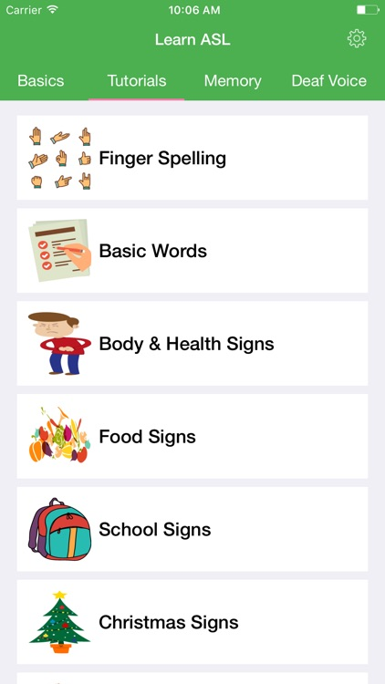
Be A Friend
3rd-5th Grade
Be A Friend Online
App of the Month
Be a Friend to those around you by learning a whole new language! The ASL app is a great way to start learning sign language along with videos and games, so you can make brand new friendships that are inclusive and meaningful.
American Sign Language is one of the most studied languages in the U.S. Not only can it be used for communicating across barriers, it can also be used to talk underwater and for great distances!
#Inovation Challenge
Try it out! What’s your favorite word or phrase to sign? Try having at least one conversation with friends or family in sign language.
“Kindness is the language which the deaf can hear and the blind can see.” – Mark Twain

Slide 12
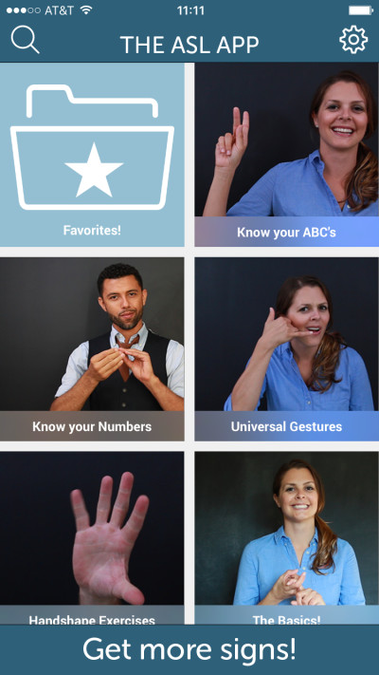
Be A Friend
6-8th Grade
Be A Friend Online
App of the Month
Be a Friend to those around you by learning a whole new language! The ASL app is a great way to start learning sign language along with videos and games, so you can make brand new friendships that are inclusive and meaningful.
Friendships can break cultural languages and barriers! We are all unique in our own way, but we have the power to be inclusive of people of all abilities!
#Inovation Challenge
Try it out! How can you include sign language everyday? Go a whole day signing as much as you can.
“Kindness is the language which the deaf can hear and the blind can see.” – Mark Twain

Slide 13
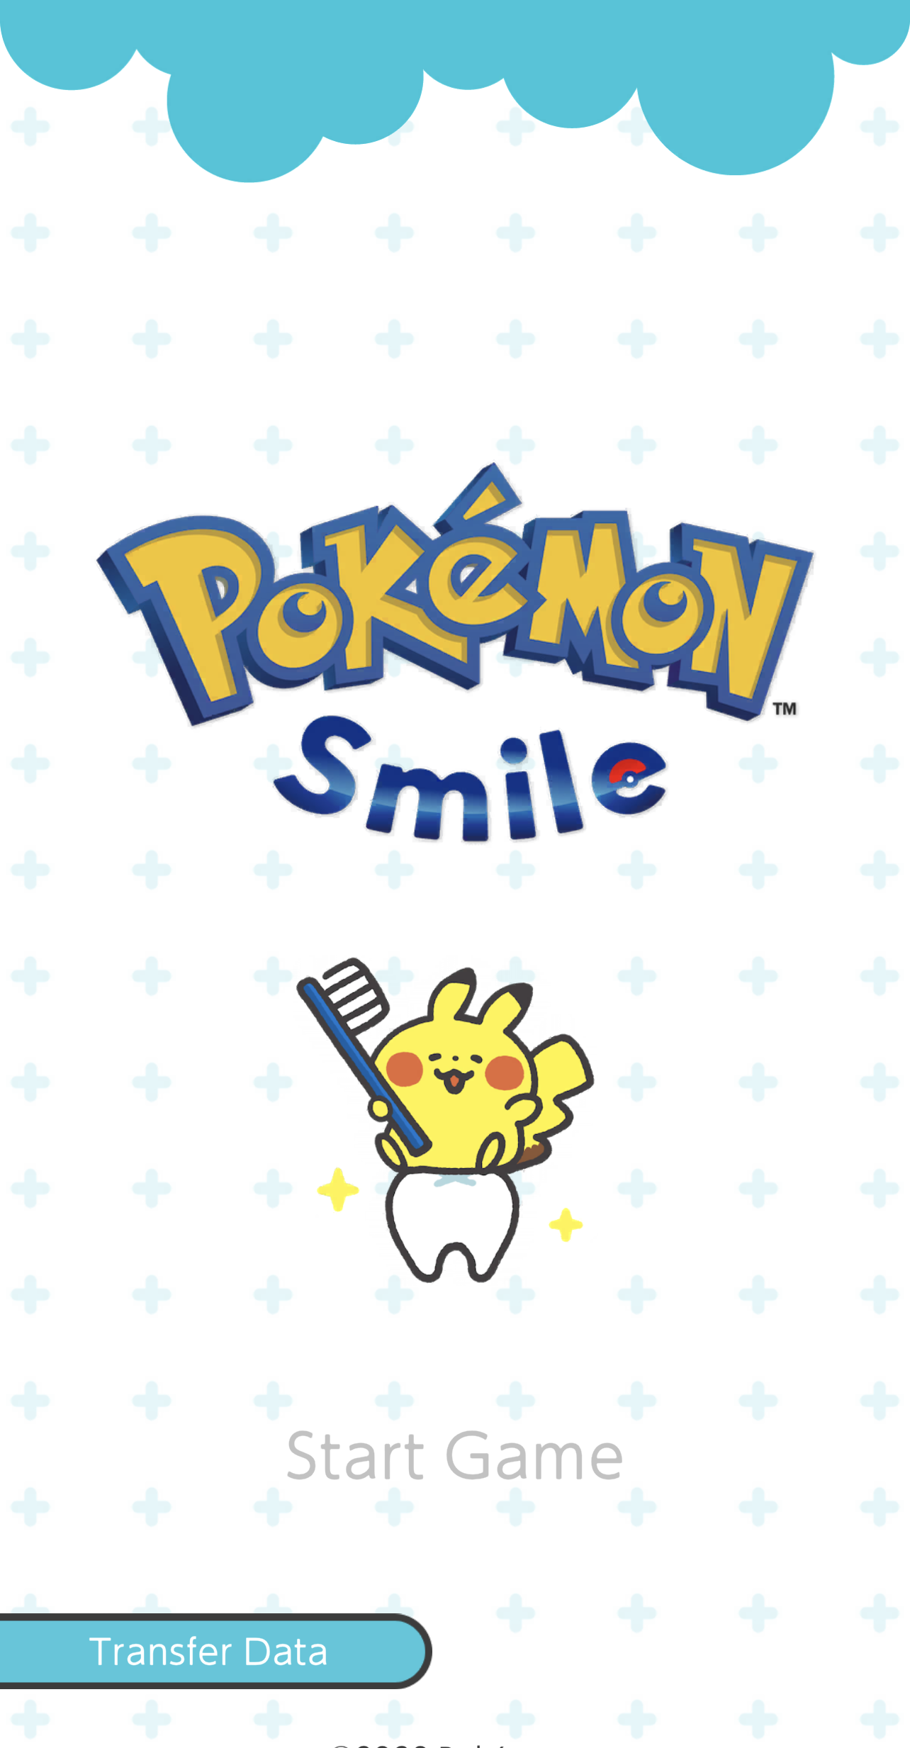
Be Encouraging
Kindergarten
Be Encouraging Online
App of the Month
Is it sometimes hard for you to brush your teeth twice a day? That's okay everyone needs a little bit of encouragement every once in a while! The app Pokémon Smile can help give you encouragement while you brush your teeth, and make sure you brush for enough time.
Encouraging others is amazing, but sometimes it's important we also make sure to encourage ourselves too!
#Inovation Challenge
Do you know any friends who also don’t like brushing their teeth? You can encourage each other to brush twice a day with this app!
“Kindness is the language which the deaf can hear and the blind can see.” – Mark Twain

Slide 14
Be Encouraging
1st-2nd Grade
Be Encouraging Online
App of the Month
Is it sometimes hard for you to brush your teeth twice a day? That's okay everyone needs a little bit of encouragement every once in a while! The app Pokémon Smile can help give you encouragement while you brush your teeth, and make sure you brush for enough time.
Encouraging others is amazing, but sometimes it's important we also make sure to encourage ourselves too! Don’t forget to treat others how you want to be treated.
#Inovation Challenge
Do you know any friends who also don’t like brushing their teeth? Tell them about this app and do it together! See how long you can go without missing a day!
“Kindness is the language which the deaf can hear and the blind can see.” – Mark Twain

Slide 15
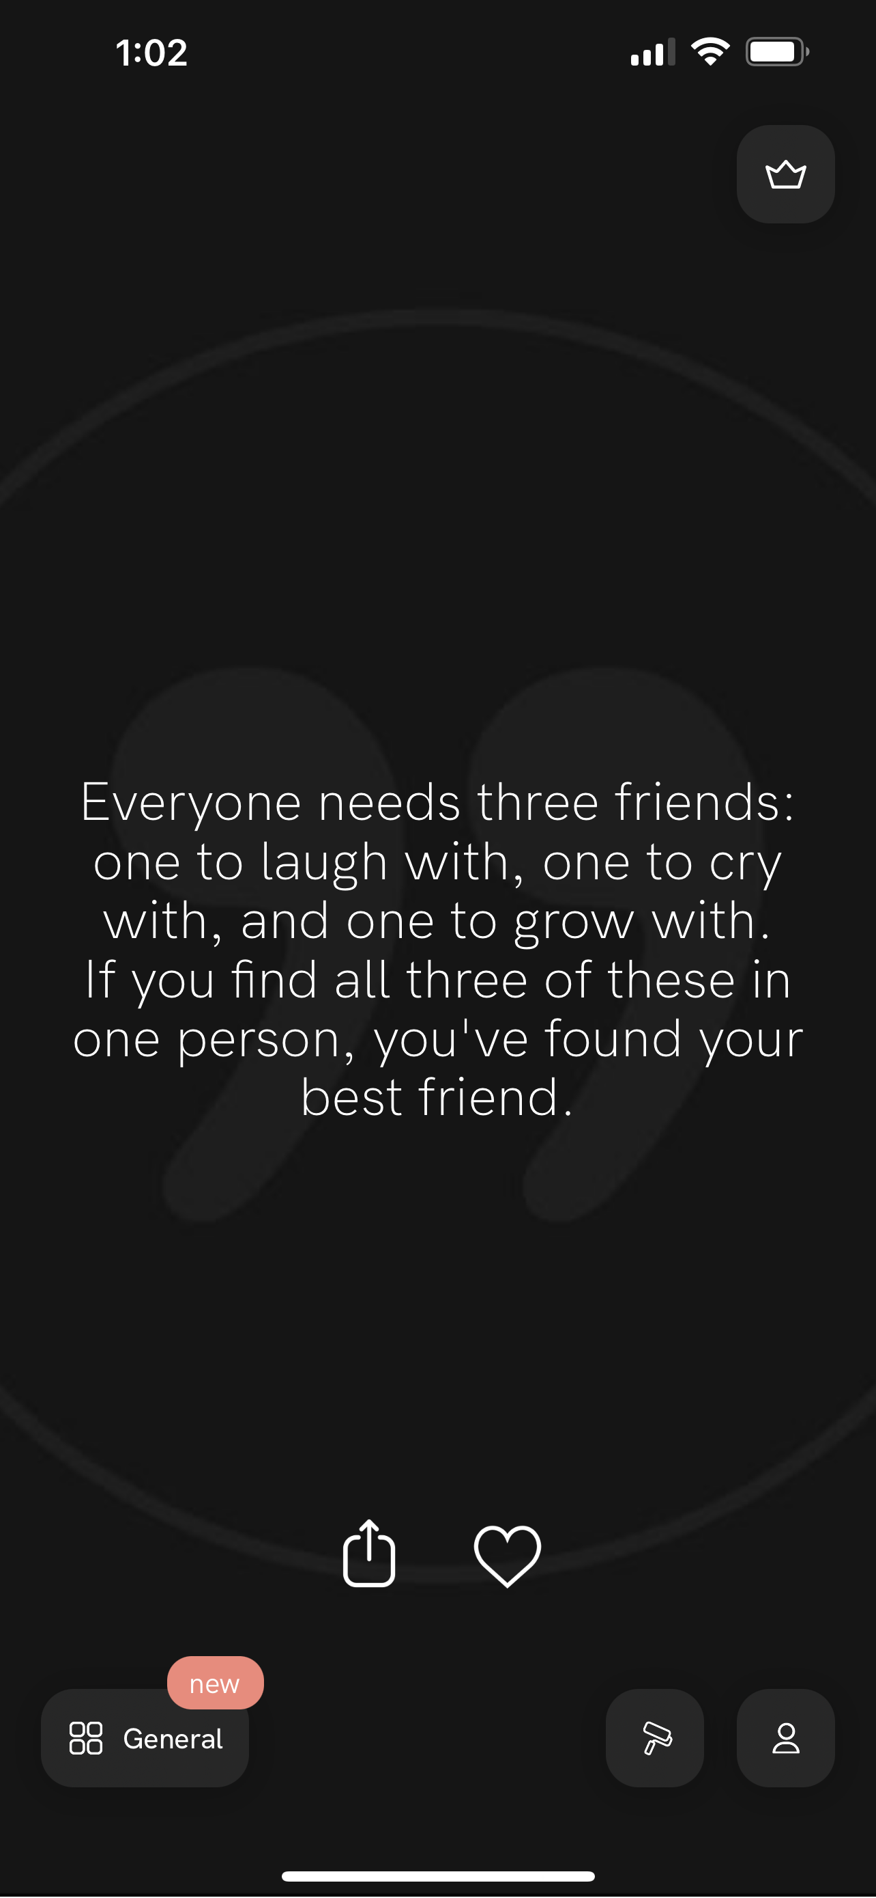
Be Encouraging
3rd-5th grade
MOTIVATION
App of the Month
Do you ever feel unmotivated throughout the day and just need a little bit of encouragement to keep going? The app Motivation is perfect for you! It gives you motivational quotes throughout your day to help you feel encouraged to get things done.
It is important we try our best to encourage everyone around us, as well as ourselves to try and brighten others' days.
#Inovation Challenge
Try this app out with a friend for two weeks! At the end of the two weeks, see how much more you were able to get done in your day!
“Kindness is the language which the deaf can hear and the blind can see.” – Mark Twain

Slide 16
Be Encouraging
6-8th grade
MOTIVATION
App of the Month
Do you ever feel unmotivated throughout the day and just need a little bit of encouragement to keep going? The app Motivation is perfect for you! It gives you motivational quotes throughout your day to help you feel encouraged to get things done.
It is important we try our best to encourage everyone around us, as well as ourselves. It is much easier to try and brighten others' days if you are in a good mood as well!
#Inovation Challenge
Try this app out with a friend for two weeks! At the end of the two weeks, see how much more you were able to get done in your day! How can you start to be encouraging for others around you?
“Kindness is the language which the deaf can hear and the blind can see.” – Mark Twain

Slide 17
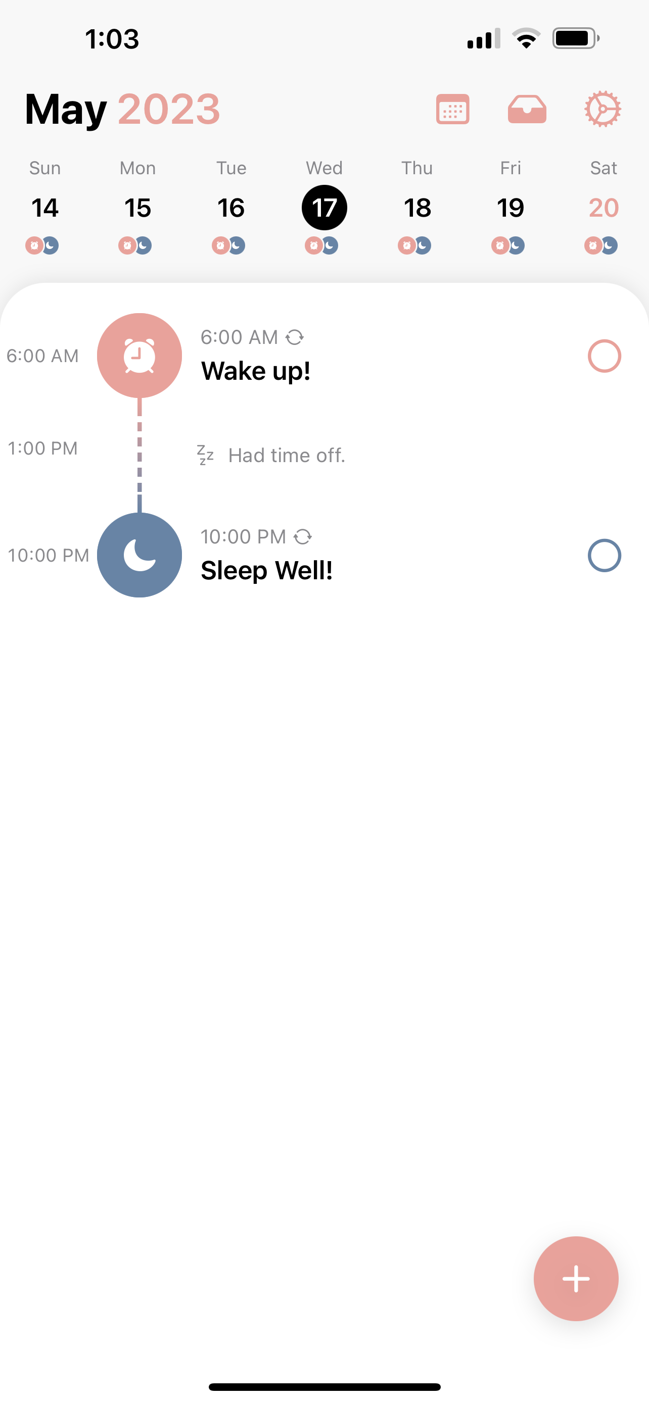
Be Respectful
Kindergarten
STRUCTURED
App of the Month
Being respectful to others is important to show that we care. To be respectful of your friends and family time, it's always great to make sure you are on time, for school, getting homework done, or even getting ready for bed. The app Structured can help you keep track of it all!
When you have a lot of tasks in the day, you can easily forget about things. It's always nice to have a friendly reminder of what you have to do!
#Inovation Challenge
What are some other ways you can practice being respectful? Being on time for your friends and family is always a great way to start!
“Kindness is the language which the deaf can hear and the blind can see.” – Mark Twain

Slide 18
Be Respectful
1st-2nd grade
STRUCTURED
App of the Month
Being respectful to others is important to show that we care. To be respectful of your friends and family time, it's always great to make sure you are on time, for school, getting homework done, or even getting ready for bed. The app Structured can help you keep track!
When you have a lot of tasks in the day, you can easily forget things. A friendly reminder of what you have to do can always help!
#Inovation Challenge
What are some other ways you can practice being respectful? Being on time for your friends and family is always a great way to start!
“Kindness is the language which the deaf can hear and the blind can see.” – Mark Twain

Slide 19
Be Respectful
3rd-5th grade
STRUCTURED
App of the Month
Being respectful to others is important to show that we care. To be respectful of your friends and family time, it's always great to make sure you are on time, for school, getting homework done, or even getting ready for bed. The app Structured can help you keep track of it all!
When you have a lot of tasks in the day, you can easily forget about things. It's always nice to have a friendly reminder of what you have to do!
#Inovation Challenge
What are some other ways you are respectful? Ask friends and family how you can help be respectful in your everyday life!
“Kindness is the language which the deaf can hear and the blind can see.” – Mark Twain

Slide 20
Be Respectful
6-8th grade
STRUCTURED
App of the Month
Being respectful to others is important to show that we care. To be respectful of your friends and family time, it's always great to make sure you are on time, for school, getting homework done, or even getting ready for bed. The app Structured can help you keep track of it all!
When you have a lot of tasks in the day, you can easily forget about things. It's always nice to have a friendly reminder of what you have to do!
#Inovation Challenge
What are some other ways you are respectful? Ask friends and family how you can help be respectful in your everyday life!
“Kindness is the language which the deaf can hear and the blind can see.” – Mark Twain

Slide 21
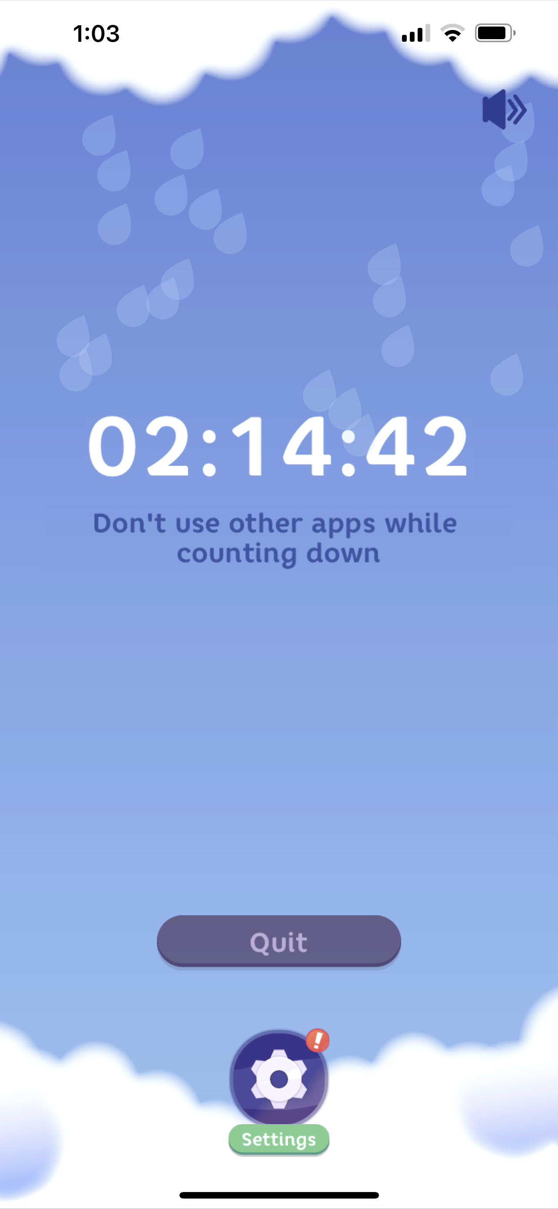
Be Thankful
Kindergarten
FOCUS PLANT
App of the Month
Being present is a great way to make sure those we care about know we are thankful for them. The app Focus Plant helps us to be with the ones we care about without any distractions. It allows us to stop using other apps and grow our plants while we are doing things in the real world.
Taking the time to step away from the screens can be good extremely beneficial for us as it gives us so much more free time!
#Inovation Challenge
Is there anyone in your life you haven't been able to hang out with as much as you would like to? Use this app to set aside time for them and see how big you can grow your plant!
“Kindness is the language which the deaf can hear and the blind can see.” – Mark Twain

Slide 22
Be Thankful
1st-2nd grade
FOCUS PLANT
App of the Month
Being present is a great way to make sure those we care about know we are thankful for them. The app Focus Plant helps us to be with the ones we care about without any distractions. It allows us to stop using other apps and grow our plants while we are doing things in the real world.
Taking the time to step away from the screens can be extremely beneficial for ourselves as it gives us so much more free time
#Inovation Challenge
Is there anyone in your life you haven't been able to hang out with as much as you would like to? Use this app to set aside time for them and see how big you can grow your plant!
“Kindness is the language which the deaf can hear and the blind can see.” – Mark Twain

Slide 23
Be Thankful
3rd-5th grade
FOCUS PLANT
App of the Month
Being present is a great way to make sure those we care about know we are thankful for them. The app Focus Plant helps us to be with the ones we care about without any distractions. It allows us to stop using other apps and grow our plants while we are doing things in the real world.
Taking the time to step away from the screens can be extremely beneficial for ourselves as it gives us so much more free time!
#Inovation Challenge
Is there anyone in your life you haven't been able to hang out with as much as you would like to? Why do you think you are on technology so much? How can you show other your thankful?
“Kindness is the language which the deaf can hear and the blind can see.” – Mark Twain

Slide 24
Be Thankful
6-8th grade
FOCUS PLANT
App of the Month
Being present is a great way to make sure those we care about know we are thankful for them. The app Focus Plant helps us to be with the ones we care about without any distractions. It allows us to stop using other apps and grow our plants while we are doing things in the real world.
Taking the time to step away from the screens can be extremely beneficial for ourselves as it gives us so much more free time
#Inovation Challenge
Is there anyone in your life you haven't been able to hang out with as much as you would like to? What things on your phone take most of your time? How can you show others you are thankful in the real world?
“Kindness is the language which the deaf can hear and the blind can see.” – Mark Twain

Slide 25
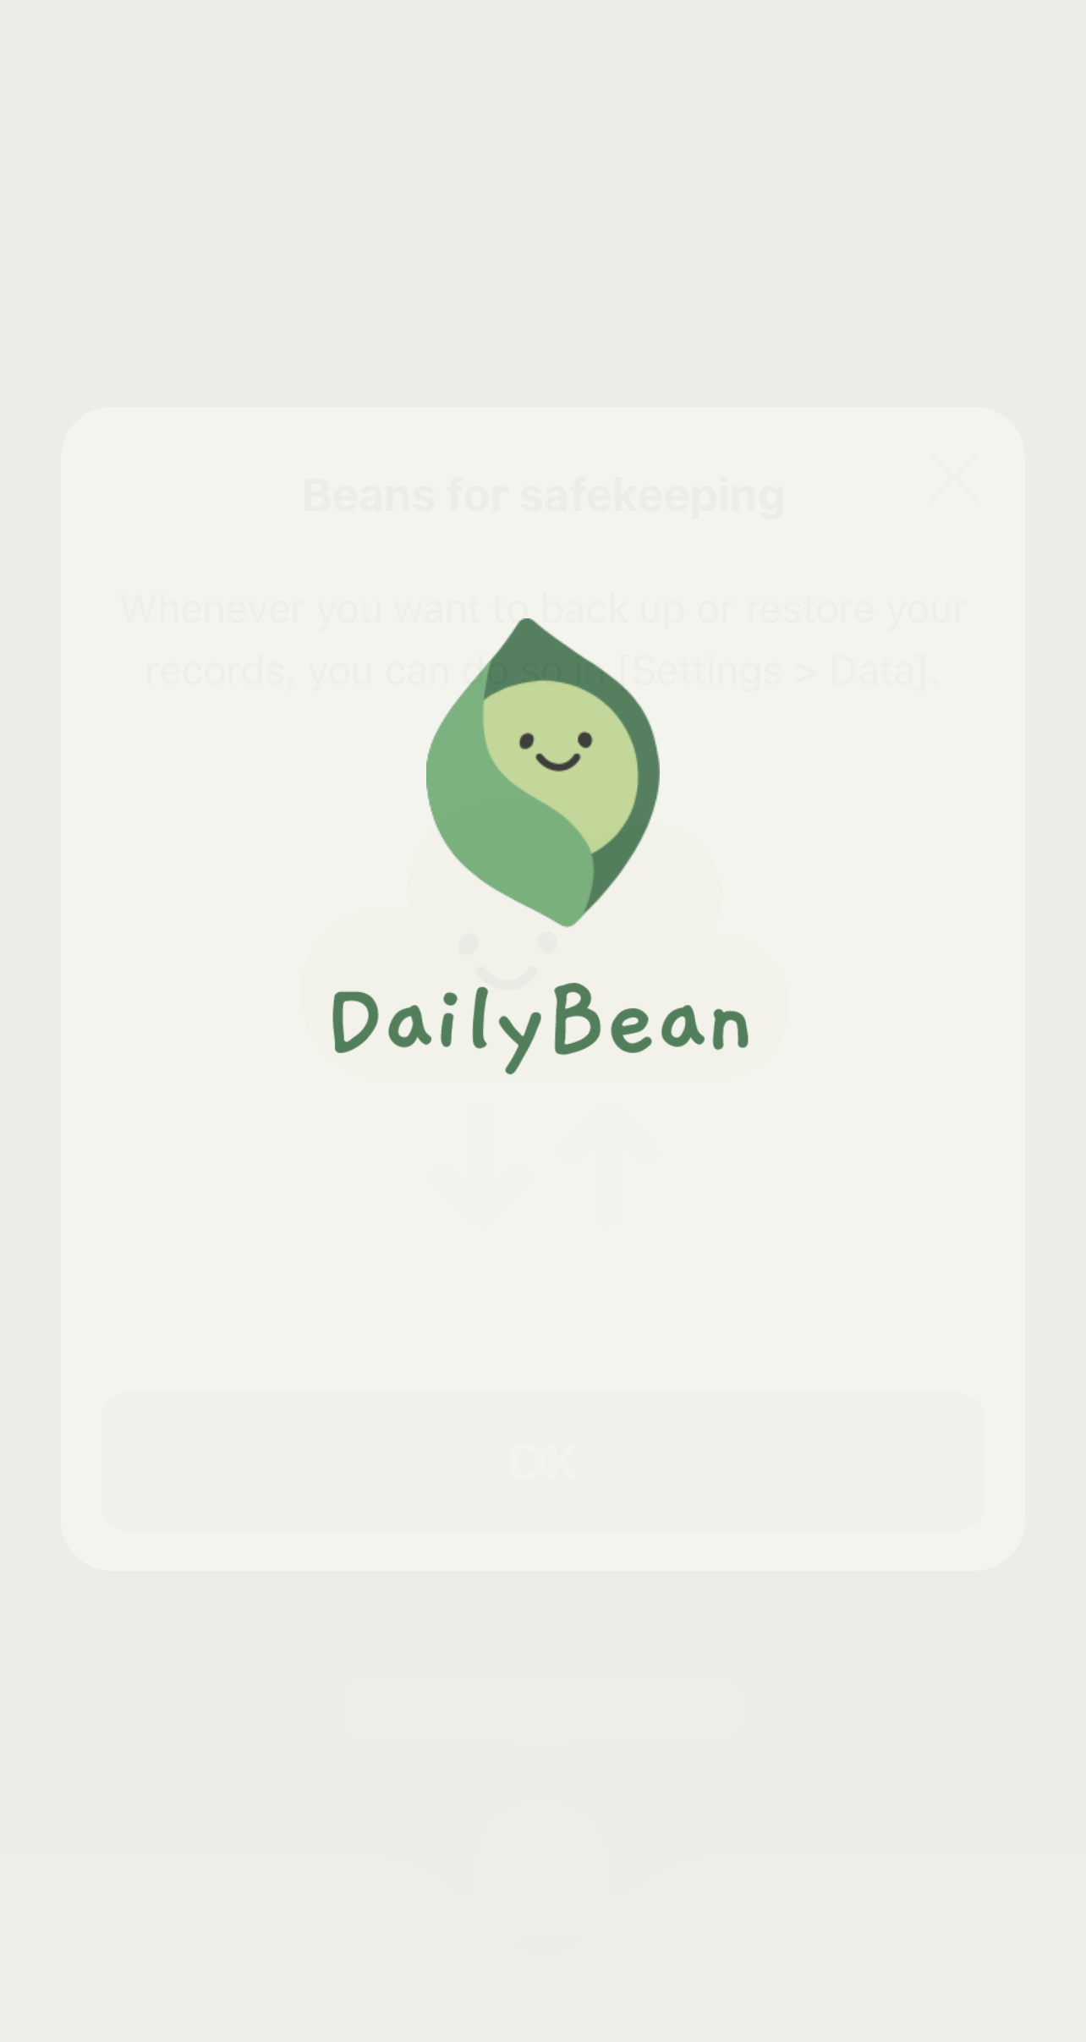
Be Supportive
Kindergarten
DAILY BEAN
App of the Month
Being supportive of others can be asking them how their day is going! Daily Bean is an app that will support you! You are able to document things like how you felt that day, things you did, and even a picture of you that day.
Being in tune with how we feel is important so we can know what we need support with.
#Inovation Challenge
Try it out! How many days can you track your feelings in a row? Do it with your friends!
“Kindness is the language which the deaf can hear and the blind can see.” – Mark Twain

Slide 26
Be Supportive
1st-2nd grade
DAILY BEAN
App of the Month
Being supportive of others can be asking them how their day is going! Daily Bean is an app that will support you! You are able to document things like how you felt that day, things you did, and even a picture of you that day.
Being in tune with how we feel is important so we can let others know what we need support with.
#Inovation Challenge
Try it out! How many days can you track your feelings in a row? Do it with your friends!
“Kindness is the language which the deaf can hear and the blind can see.” – Mark Twain

Slide 27
Be Supportive
3rd-5th grade
DAILY BEAN
App of the Month
Being supportive of others can be asking them how their day is going! Daily Bean is an app that will support you! You are able to document things like how you felt that day, things you did, and even a picture of you that day.
Being in tune with how we feel is important so we can know what we need support with.
Everyone needs to be supported, including you!
#Inovation Challenge
Try it out! How many days can you track your feelings in a row? Can you notice any patterns? Get your friends to do it with you!
“Kindness is the language which the deaf can hear and the blind can see.” – Mark Twain

Slide 28
Be Supportive
6-8th grade
DAILY BEAN
App of the Month
Being supportive of others can be asking them how their day is going! Daily Bean is an app that will support you! You are able to document things like how you felt that day, things you did, and even a picture of you that day.
Being in tune with how we feel is important so we can know what we need support with. Everyone needs to be supported, including you!
#Inovation Challenge
Try it out! How many days can you track your feelings in a row? Can you notice any patterns? Get your friends to do it with you! How are you making an effort to be supportive?
“Kindness is the language which the deaf can hear and the blind can see.” – Mark Twain

Slide 29
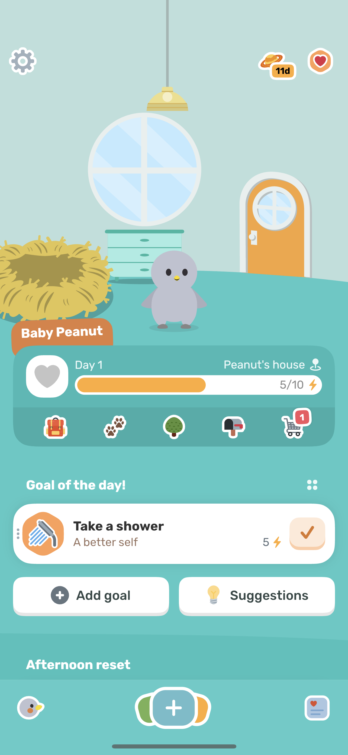
Be Positive
Kindergarten
FINCH
App of the Month
Having positivity can be hard to do sometimes. It’s okay because Finch is here to help you! It is an app that helps you get your day started and keep it going. You can set goals for the day and when you achieve them get points, all while growing your animal. This app helps you to feel better prepared and positive throughout your day.
Being positive can uplift those around you. When you have a daily reminder it is much easier to spread positivity to others.
#Inovation Challenge
Do you love to be positive? What things or people always make your day positive?
“Kindness is the language which the deaf can hear and the blind can see.” – Mark Twain

Slide 30
Be Positive
1st-2nd grade
FINCH
App of the Month
Having positivity can be hard to do sometimes. It’s okay because Finch is here to help you! It is an app that helps you get your day started and keep it going. You can set goals for the day and when you achieve them get points, all while growing your animal. This app helps you to feel better prepared and positive throughout your day.
Being positive can uplift those around you. When you have a daily reminder it is much easier to spread positivity to others.
#Inovation Challenge
Do you love to be positive? How can you be positive in your everyday life?
“Kindness is the language which the deaf can hear and the blind can see.” – Mark Twain

Slide 31
Be Positive
3rd-5th grade
FINCH
App of the Month
Having positivity can be hard to do sometimes. It’s okay because Finch is here to help you! It is an app that helps you get your day started and keep it going. You can set goals for the day and when you achieve them get points, all while growing your animal. This app helps you to feel better prepared and positive throughout your day.
Being positive can help uplift those around you. When you have a daily remind like Finch, it is much easier to spread positivity to others.
#Inovation Challenge
Do you love to be positive? Share this app with 3 friends and see how achieving your daily goals can bring positivity to your life.
“Kindness is the language which the deaf can hear and the blind can see.” – Mark Twain

Slide 32
Be Positive
6-8th grade
FINCH
App of the Month
Having positivity can be hard to do sometimes. It’s okay because Finch is here to help you! It is an app that helps you get your day started and keep it going. You can set goals for the day and when you achieve them get points, all while growing your animal. This app helps you to feel better prepared and positive throughout your day.
Being positive can help uplift those around you. When you have a daily remind like Finch, it is much easier to spread positivity to others.
#Inovation Challenge
How much of your day do you spend looking for the positives vs the negatives? What are some positives in your life right now? Share this app with 3 friends and see how achieving your daily goals can bring positivity to your life.
“Kindness is the language which the deaf can hear and the blind can see.” – Mark Twain

Slide 33
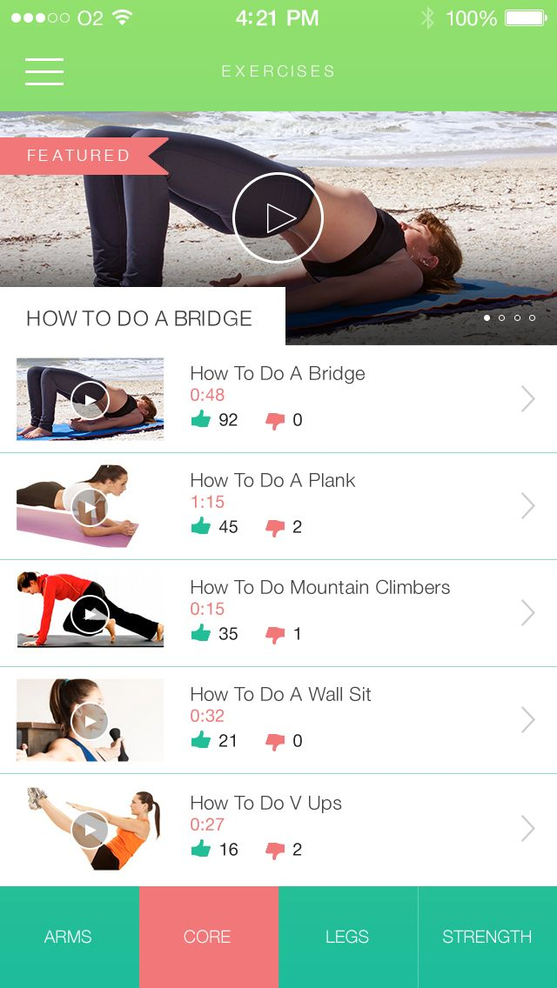
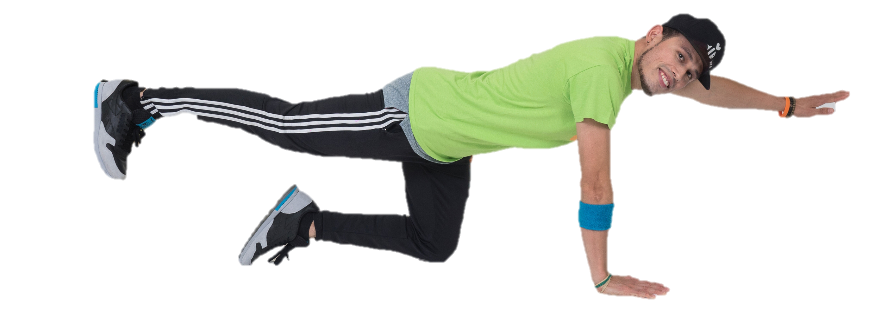
Be Responsible
Kindergarten
Be Responsible Online
App of the Month
30 Day Fitness Challenge is a phone app that gives you the chance to get stronger each day! There are many workouts and videos available to learn from!
We can be responsible online by choosing apps that are healthy for our bodies and minds. Choose sites that will make you smarter and stronger!
#Inovation Challenge
We all have to recharge! Take a break and put your devices on the charger. Close your eyes, take a few deep breaths, and concentrate on something that makes you happy.
“Kindness is the language which the deaf can hear and the blind can see.” – Mark Twain

Slide 34
Be Responsible
1st-2nd grade
Be Responsible Online
App of the Month
30 Day Fitness Challenge is a phone app that gives you the chance to get stronger each day! There are many workouts and videos available to learn from!
We can be responsible online by choosing apps that are healthy for our bodies and minds. Choose sites that will make you smarter and stronger!
#Inovation Challenge
We all have to recharge! Take a break and put your devices on the charger. Close your eyes, take a few deep breaths. What do you imagine to help calm you down?
“Kindness is the language which the deaf can hear and the blind can see.” – Mark Twain

Slide 35
Be Responsible
3-5th grade
Be Responsible Online
App of the Month
30 Day Fitness Challenge is an app that takes you on a fitness journey and encourages you to strengthen each day of the month. There are many workouts and videos available to learn from!
We can be responsible online by choosing apps that are healthy for our bodies and minds. Choose apps that will make you smarter and stronger!
#Inovation Challenge
Try this out with a friend for a week! Did it help you in your everyday life at all? If so how?
“Kindness is the language which the deaf can hear and the blind can see.” – Mark Twain

Slide 36
Be Responsible
6-8th grade
Be Responsible Online
App of the Month
30 Day Fitness Challenge is an app that takes you on a fitness journey and encourages you to strengthen each day of the month. There are many workouts and videos available to learn from!
We can be responsible online by choosing apps that are healthy for our bodies and minds. Choose apps that will make you smarter and stronger!
#Inovation Challenge
Try this out with a friend! For a month try to do a few workouts a week. How can you be responsible to complete the tasks every week. What will keep you going?
“Kindness is the language which the deaf can hear and the blind can see.” – Mark Twain

Slide 37
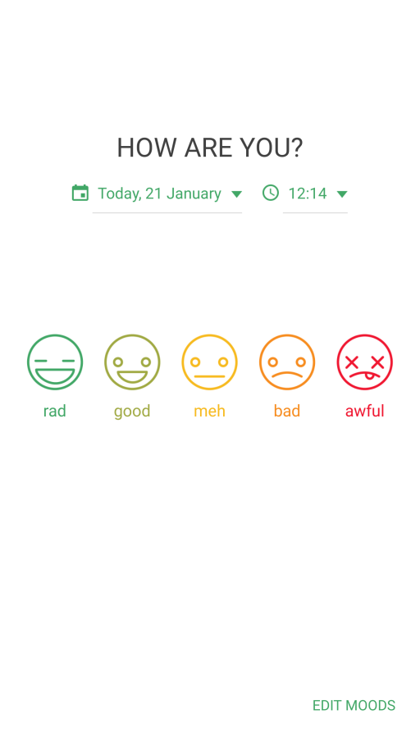
Be Helpful
Kindergarten
Be Helpful Online
App of the Month
We are in control of our words and reactions when dealing with different emotions. Daylio is a quick and colorful journal that helps you keep track of your mood every day. You can even create a pin to keep your personal thoughts and emotions safe!
Keeping a journal is a helpful way for you to notice your emotions! It helps use know what might be bothering us too!
#Inovation Challenge
Keep track of your emotions every day for one week and write down something that made you feel that way. What are some things that made you happy and why?
“Kindness is the language which the deaf can hear and the blind can see.” – Mark Twain

Slide 38
Be Helpful
1st-2nd grade
Be Helpful Online
App of the Month
We are in control of our words and reactions when dealing with different emotions. Daylio is a quick and colorful journal that helps you keep track of your mood every day. You can even create a pin to keep your personal thoughts and emotions safe!
Keeping a journal is a helpful way for you to notice your emotions so you can alternate your reaction and delete the chance for negativity to occur.
#Inovation Challenge
Keep track of your emotions every day for one week and write down something that made you feel that way. What could you have done to react differently in the moment?
“Kindness is the language which the deaf can hear and the blind can see.” – Mark Twain

Slide 39
Be Helpful
3-5th grade
Be Helpful Online
App of the Month
We are in control of our words and reactions when dealing with different emotions. Daylio is a quick and colorful journal that helps you keep track of your mood every day. You can even create a pin to keep your personal thoughts and emotions safe!
Keeping a journal is a helpful way for you to notice your emotions so you can alternate your reaction and delete the chance for negativity to occur.
#Inovation Challenge
Keep track of your emotions every day for one month. Write about how you felt that day and why, then look at the Monthly Mood Chart in the app. How would you summarize that month? What were some positive things that happened?
“Kindness is the language which the deaf can hear and the blind can see.” – Mark Twain

Slide 40
Be Helpful
6-8th grade
Be Helpful Online
App of the Month
We are in control of our words and reactions when dealing with different emotions. Daylio is a quick and colorful journal that helps you keep track of your mood every day. You can even create a pin to keep your personal thoughts and emotions safe!
Keeping a journal is a helpful way to notice your emotions so you can alternate your reaction and delete the chance for negativity to occur.
#Inovation Challenge
Keep track of your emotions every day for one month. Write about how you felt that day and why, then look at the Monthly Mood Chart in the app. What were some trends you saw in the month? How can you improve your mood in the future?
“Kindness is the language which the deaf can hear and the blind can see.” – Mark Twain

